Slide 1

Financial Analysis

Slide 2
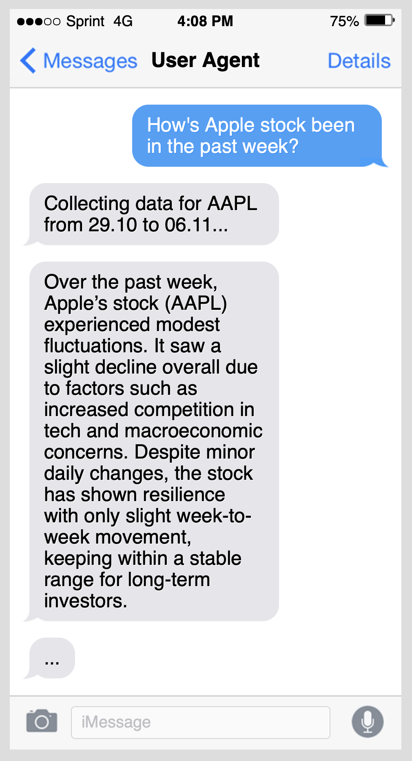
User Interaction Agent
Communicates with the user through a user-friendly interface
Provides insightful answers
Helps users understand available features and gives tips for optimal use
Gathers feedback on how the data should be presented

Slide 3

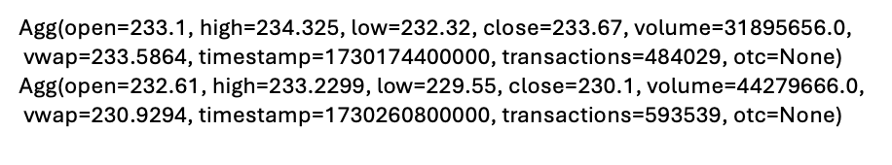
Financial Data Retriever Agent
Scrapes website for relevant data:
{
ticker = ‘AAPL’,
timespan = "day",
from = "2024-10-29",
to = "2024-11-06",
}

Slide 4

Financial analysis
Data Analyst – identifies trends in the stock’s evolution
Forecaster – applies predictive models
Market Sentiment Analyst - analyze public sentiment around specific stocks, industries, or economic indicators
Risk Advisor – evaluates potential risks for investments
Trading Strategist – develops trading strategies based on financial data, forecasts, and/or user-defined rules

Slide 5


APIs & Resources
https://polygon.io/docs/stocks/getting-started
https://github.com/polygon-io/client-python
https://github.com/ranaroussi/yfinance

Slide 6


APIs & Resources
Multi AI Agent Systems with crewAI
https://learn.deeplearning.ai/courses/multi-ai-agent-systems-with-crewai/lesson/15/mutli-agent-collaboration-for-financial-analysis-(code)

